Slide 1
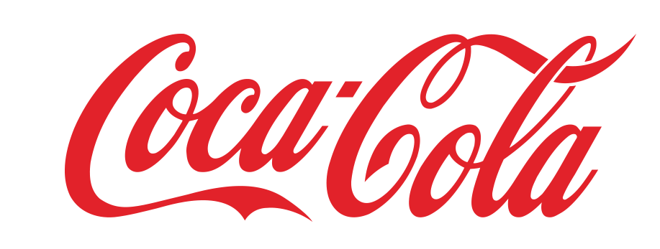
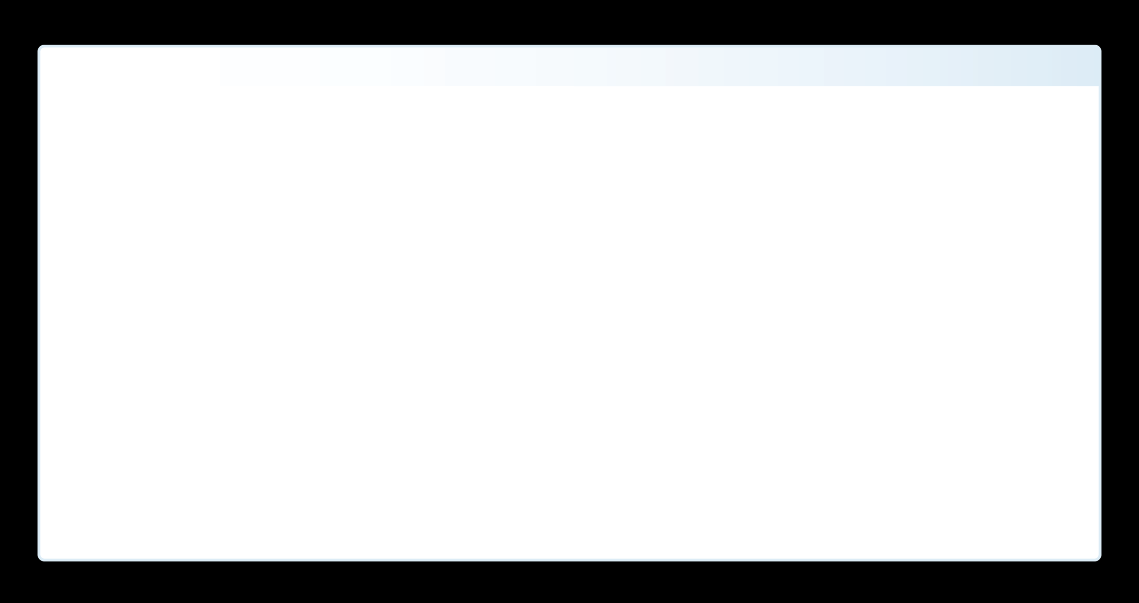

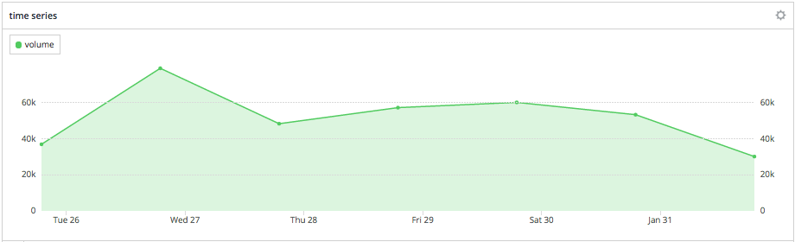
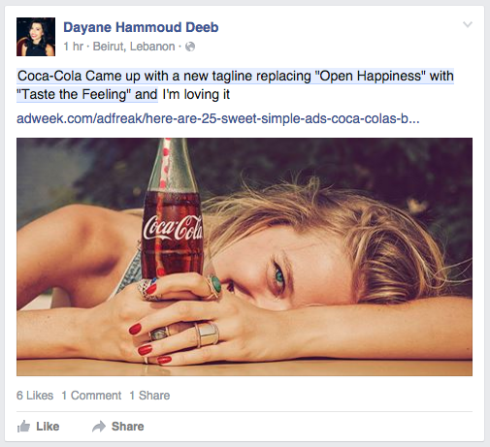
Report 2-1-2016
Taste the Feeling Facebook Topic Data
A | Campaign Flow and Statistics
Insightpool aggregated every Facebook post relative to the “Taste the Feeling” launch starting 1/21/16, until 2/2/16. Insightpool was able to distinguish the key drivers of the campaign word of mouth as it progressed on the world’s largest source of public opinion. First, news articles were the source of the conversation that was mainly being had by marketers and stakeholders. Celebrity advocates then influenced the conversation amidst their fans via event marketing and advocate messaging, particularly fans in Philippines and Columbia. Once the word of mouth surrounding the celebrities and their events settled, GIF authors began sharing their “feelings” in a humorous light. Recently, an opposition has emerged with a health-conscience agenda lead by brands like Cross-Fit and publicized by like-minded media outlets. Insightpool
Media
Advocates
GIF Authors
Opposition
1/19/16-1/21/16
1/22/15-1/25/16
1/25/15-1/26/16, 2/1/16
1/22/15-1/25/16
Regions
25-34
Marketers
International
Phillipines, Columbia
Celebrities
Regions
Demographic
Celebrities
USA
Health/Bully
Brands/Media
Media| Sample Post
Advocates| Sample Post
Opposition| Sample Post
Campaign Overview
A | Gender
B |Age

Slide 2
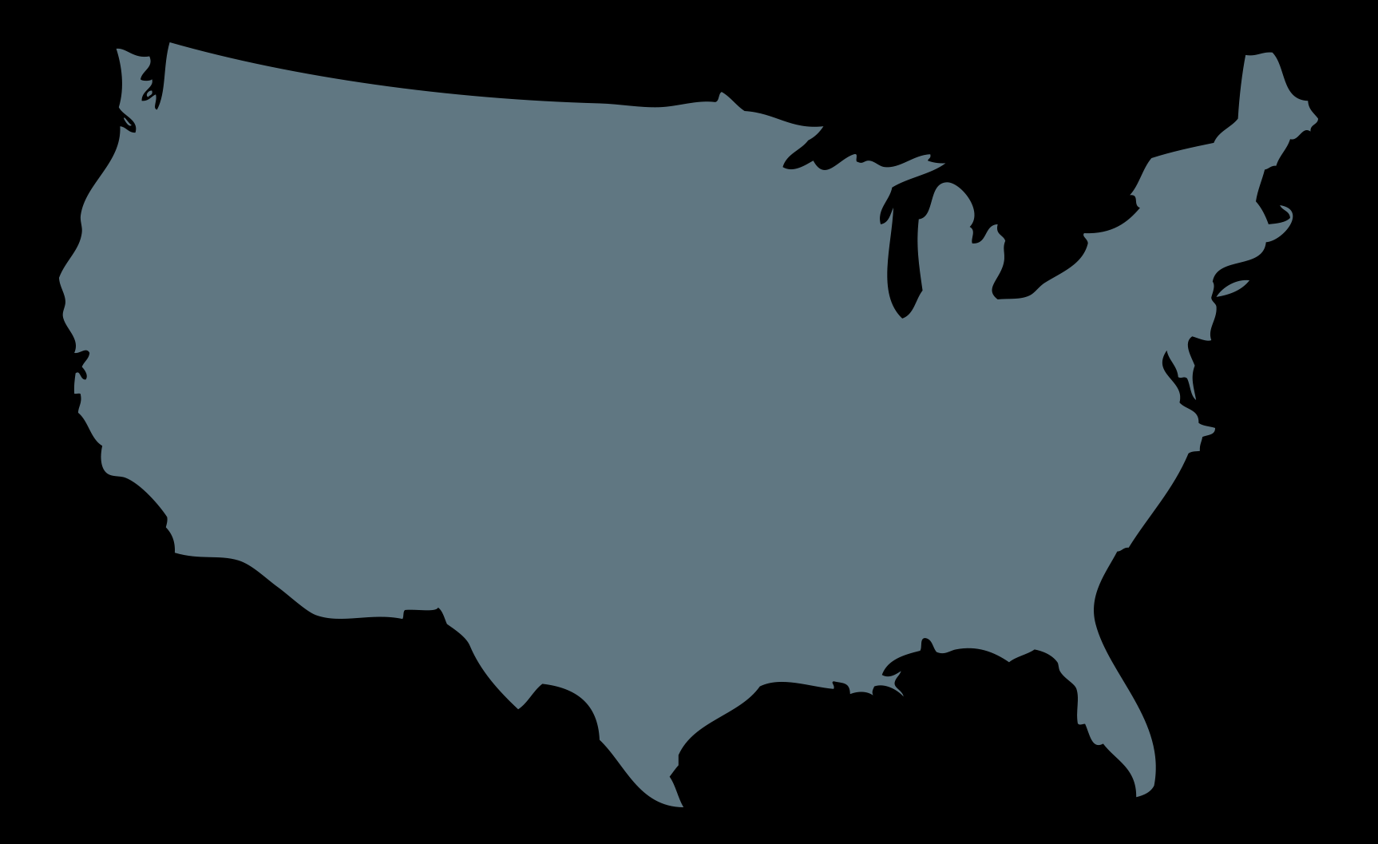
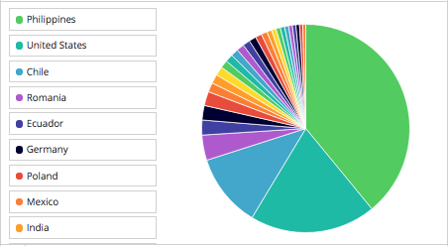
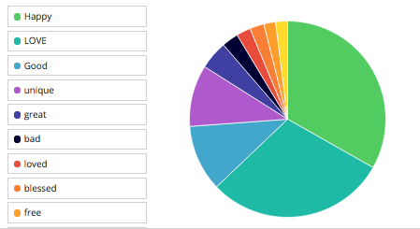
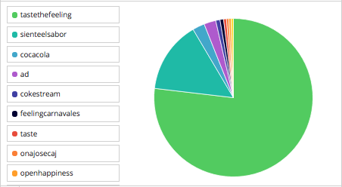
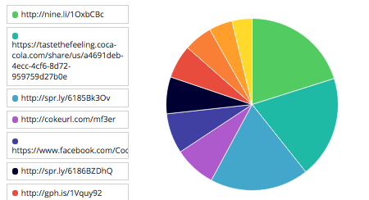
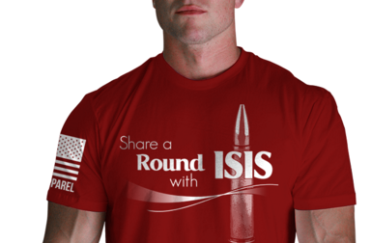
Report 2-1-2016
Geo (by Country)
Feelings
Hashtags
Links

